Slide 1
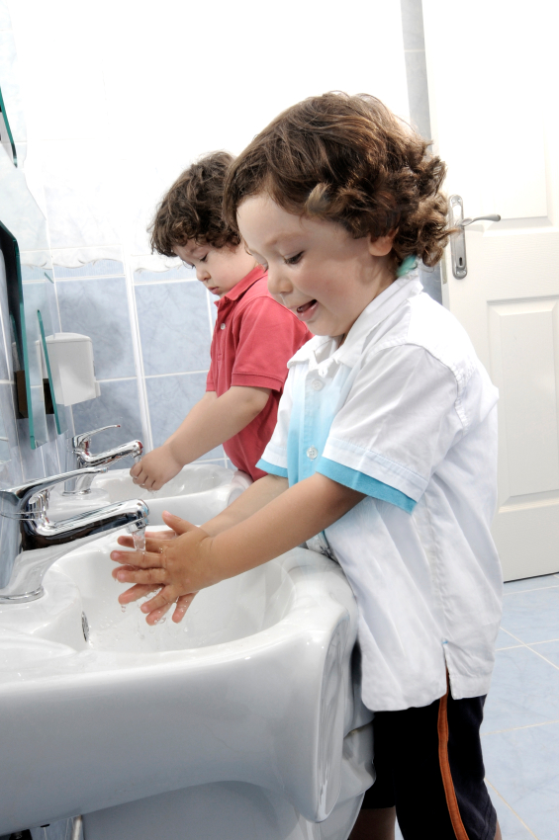
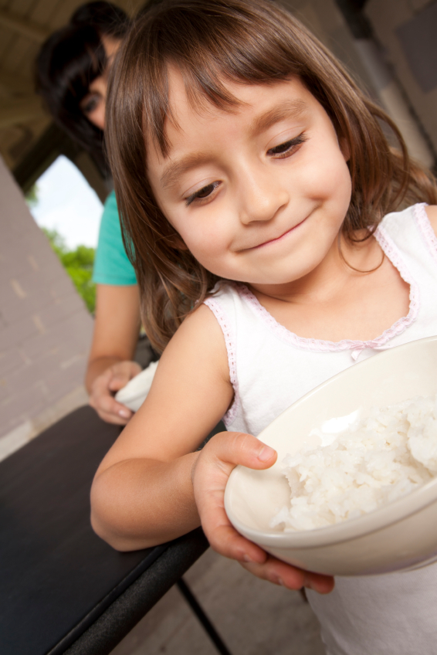
Count, Read, Share
The Meal Table as a Learning Center

Slide 2
Rethinking Nutrition Workshop Series
Yummy Carrot Sticks: How Children Learn to Like Nutritious Foods
Avoiding food power struggles, Role modeling healthy eating
What’s for Snack? Nutrition to Support Healthy Growth
Good nutrition, Lifelong food habits, Obesity
Cupcakes for Lunch? Creating a Food & Nutrition Policy for Your Early Care & Education Program
Nutrition policy, Family food practices
Count, Read, Share: The Meal Table as a Learning Center
Mealtime learning activities, Life skills, Social skills
Notes:
TELL: Today’s workshop is shown in orange and is one of 4 in a series about nutrition in early childhood education and care settings.
NOTE: Facilitators, you can add more details regarding whether the other workshops will be offered. For instance, We had workshop # ? last month. If there is interest, we’ll hold the other workshops in the months ahead. We have arranged Registry credit for each of these.

Slide 3
Notes:
TELL: This workshop series is based on this book, which was written by 2 professors at the University of Wisconsin along with 2 Wisconsin early care and education professionals. If you want to take a look at it, I’ll have a sample copy up front after the workshop, and also some information on how to purchase a copy. Throughout the workshop, we also reference Healthy Bites, which was written in Wisconsin and focuses primarily on nutrition and supporting a healthier environment for children in the early care and education settings. Healthy Bites is available free online.

Slide 4
Mealtimes support children’s social, emotional and intellectual development.
Notes:
Read slide.
TELL: Research finds that responsive, well-organized, and well-regulated mealtimes predict better child outcomes in a wide variety of areas, not just in nutrition. We can nurture children’s minds as well as their bodies at mealtime.

Slide 5
Why is mealtime a good place for children to learn?
Ritualized – Repeated - Remembered
Most families have unwritten rules or norms about how people should act at the meal table
Norms vary across culture
But most families
in the U.S. share
mealtime values
Notes:
TELL:
Ritualized-Repeated-Remembered: Because mealtimes become ritualized, with the same rules and actions repeated every day, they are a more effective setting for teaching and learning than are most other parts of the early care & education day. Children benefit from the comfort of predictability and a sense of control of their life.
Norms vary across culture but most Americans think that mealtime means, all members of the family are together, all members of the family are together, meal lasts for more than just a few minutes, and everyone at the table contributes to pleasant conversation. Even though parents have the idea and goal of a family mealtime, they don’t always succeed in creating one.
ASK: Why do you think some families don’t have family meal times? (Possible responses include: children’s activities, work schedules, lack of effort or organization)
TELL: For children who don’t have family mealtime at home, shared meal and snack times at their early care & education program can be especially important.

Slide 6
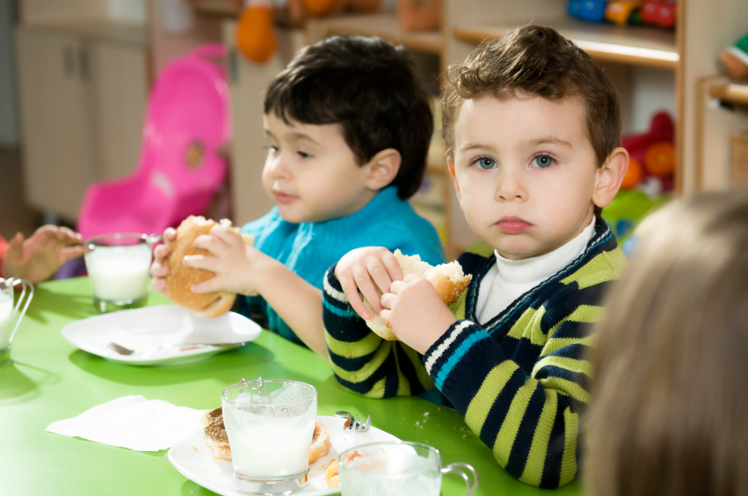
Social Development Around the Meal Table
Mealtime is a good place to teach children about getting along with others because:
Group setting
Activity recurs every day at the same time
Well-defined roles and a common purpose
Sharing becomes habit or ritual
Notes:
TELL: Children learn how to interact socially at the meal or snack table.
Read slide.

Slide 7
Socially, what do children learn at the meal table?
Problem solving
Behavioral Self-Regulation: Impulse Control
Cognitive Self-Regulation: Planning
Practical Life Skills
Self-Responsibility
Notes:
TELL: We’ll go into each of these aspects of social development in more detail. Children learn many social skills at the table, including . . .
Read slide.

Slide 8
Problem Solving
Learning how to solve conflicts with other children in competent and socially acceptable ways (i.e., no pushing or hitting)
Difficult for toddlers:
Driven to increased independence and autonomy
Adults exert social pressure to teach respect for the needs of others, too.
Notes:
Read slide.
TELL: Problem solving is especially difficult for toddlers because 1) they are driven to exercise increasing independence and autonomy, to assert themselves more as an individual, but at the same time 2) adults must exert socialization pressure on them, teaching them that they cannot always get their own way, that the needs of others are also important.

Slide 9
Problem Solving at Mealtime
Taking turns
Passing a serving platter around the table
Sharing
Splitting a snack into portions
Expressing feelings
“Using your words” to tell other children how you feel when there is a dispute
Notes:
TELL: The meal table offers excellent opportunities for children to work on problem solving. For instance, at the meal table practice . . .
Read slide.
ASK: What are some examples you’ve seen recently of children learning how to solve problems at the meal table?

Slide 10
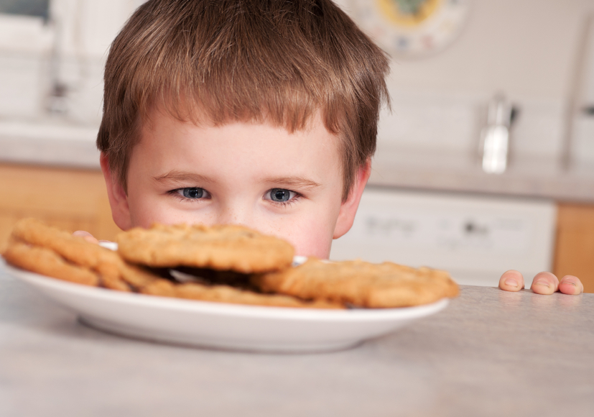
Behavioral Self-Regulation: Impulse Control
Both the ability to stop oneself from doing something and the ability to control the speed at which something is done
Children first learn how to do an action and THEN learn how to regulate an action
Thus, they have a hard time stopping themselves in action.
Notes:
TELL: Impulse control is another skill central to children’s social development.
Read slide.
ASK: For instance, imagine a preschooler helping you stack freshly baked cookies. If you say, don’t eat the cookies, what have you focused their attention on, what image have you put in their mind? (Answer: the idea of eating a cookie!)
ASK: What will the preschooler likely do? (Answer: bite into a cookie!)
TELL: Yes, it is usually a mistake to draw attention to the thing we hope to prevent.
ASK: What else could you say that would help a preschooler learn the action of not eating the cookies the minute they have an impulse to eat them?
TELL: One example would be to ask the child to put a paper towel over the cookies to keep them warm. It is always better to give a child another task when you want to regulate impulses.
ASK: Can you think of ways we ask children to control themselves at the meal table?

Slide 11
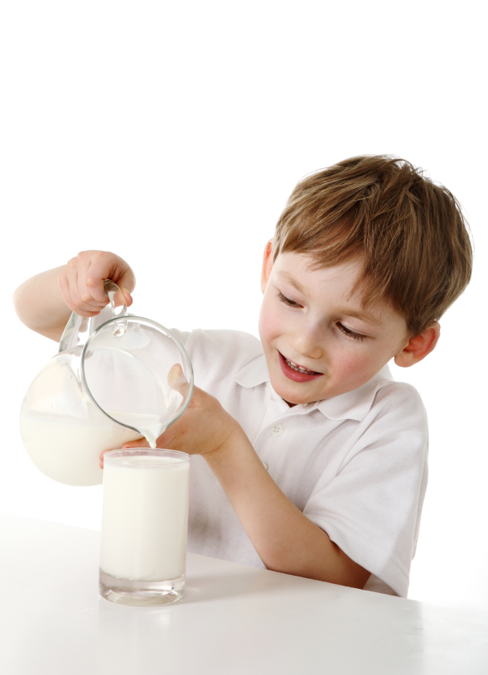
Replace Don’t With Do
Don’t is the first and easiest thing adults say.
Don’t spill the milk.
Don’t doesn’t teach, it only prohibits.
Telling children how to do something right or competently teaches.
Use your helper hand under the pitcher. That’s it!
Notes:
TELL: One way to help preschoolers master impulse control is to replace “don’t” with “do” when a child begins to misbehave at the meal table.
Read slide.
By telling children what they can “do,” we create positive images of better behavior in a child’s head – behaviors that they may have trouble imagining on their own because they are still learning.

Slide 12
DON’T | DO
Don’t spill your milk. | Use your helper hand under the pitcher.
Don’t touch Miguel’s food.
Don’t play with your food.
Don’t take all the carrots.
Don’t talk with your mouth full.
Stop elbowing LeShawn.
Stop pounding the table.
Don’t stuff your mouth so full.
Hold your sandwich with both hands.
Use your spoon to scoop up the peas.
Take three or four carrots. You can have more when you finish those.
Finish chewing and then tell me.
Tuck your elbows close to your sides.
Ask to be excused from the table.
Put your fork down while you chew.
Notes:
ASK: How might we rephrase these “don’t” statements to create images of positive behavior for kids?
NOTE: Click to reveal “do” examples one by one.
Don’t play with your food = Put your fork by the side of your plate between bites.
Don’t play with your food = When you are full, you may ask to be excused from the table.
ASK: Can you think of any other “don’t” statements we sometimes give to children at the table? (For each new statement, ASK: How might we rephrase that as a “do” statement?”
NOTE: Additional clicks on this slide will reveal examples in the “do” column.
Allow participants to read examples of DO statements and see how they compare to their suggestions.

Slide 13
Cognitive Self-Regulation: Planning
Young children are impulsive not only in their actions but also in their thinking and decision making – their planning.
Planning and cognitive self-regulation impact children in the long term.
School
Health
Notes:
TELL: Like impulse control, planning is central to children’s development of social skills.
Read slide until school and health points; then explain the following.
TELL:
(School) Research shows that children with a low ability to plan their actions and decisions tend to do poorly in school.
ASK: Why do you think planning might be important to school success? (Requires thinking about the future, being able to order actions (1st this than that), short term actions have long term consequences)
TELL:
(Health) Self-regulation may also impact children’s health. Research has found that children with poorer self-regulation at age 3-4 were more overweight at age 11-12. Children who are better at self-regulation can delay gratification and make healthy choices about food and health.

Slide 14
Practice Planning at Mealtimes
Foreshadowing: Early warning for what happens next
After we have finished lunch, we will need to clean the table before we can go outside.
Model a Course of Action: Think and plan out-loud
Let’s see before we set the table for lunch, what do we need to do? That’s right, we need to wash our hands.
Notes:
TELL: Foreshadowing gives children time to think about what happens next and to prepare for the next transition by warning children that it is almost time to finish their activities or wash their hands for lunch. Foreshadowing also tells children what the next step will be.
Read first example (“After we have finished lunch . . .”)
TELL: Modeling a course of action simply means that you think and plan out-loud so that children can hear how the teacher or an adult organizes her actions.
Read second example (“Let’s see before we set the table . . .”)

Slide 15
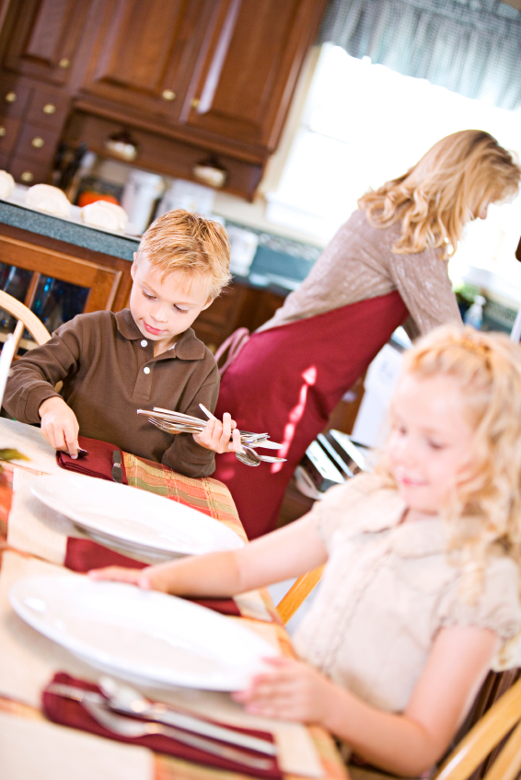
Practice Planning at Mealtimes
Break larger tasks into small steps and give children more to do as they are able
“Sara, please put a napkin at every place at the table.” vs. “Sara, please set the table.”
For an older child: “Sara, tell me what needs to be done to set the table.”
Notes:
TELL: Young children may not be able to plan all the steps necessary to complete an action but by giving them small tasks that are matched to their ability you help them see the parts of the task. You can ask a child to do more of the planning of a task as they gain in this ability.

Slide 16
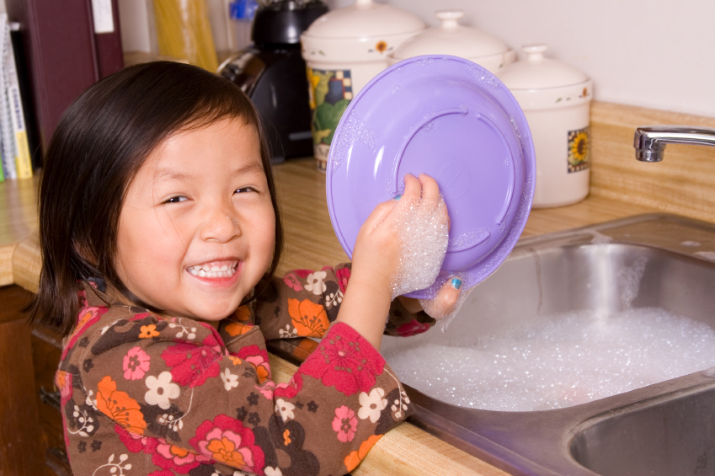
Practical Life Skills & Self-Responsibility
When children do things for themselves, they are taking responsibility for their own doing and learning.
Chores related to mealtime teach practical life skills
Children feel pride in accomplishing mealtime tasks or chores
Notes:
TELL: As young as two years old, children are ready and eager to start helping and doing things for themselves.
ASK: How many of you have heard “I can do it myself!” from a toddler?
TELL: Young children especially love to copy the actions of adults so chores seem like fun to them and they are proud to be able to complete the tasks.
ASK: What are some self-help chores you give children at mealtime? (Hear answers)
TELL: Yes, some examples included washing the table, setting the table, preparing foods, serving foods, clearing plates, or washing the table after eating.

Slide 17
Teaching Practical Life Skills
Explain and Demonstrate
Show how to do a chore and talk about what you are doing
Practice with Feedback – especially positive
Provide Supports
Make it easy for children to succeed by providing the necessary tools for chores.
Give Reminders
Notes:
TELL: Children are more likely to learn these life skills if we . . .
TELL: Have children try a chore, tell them how they are doing, and focus mostly on what they do right.
TELL: Children also learn these life skills if we make it easy for them to succeed. For example, we can provide the necessary tools such as small buckets and sponges for children to wash tables or providing a low spot for dirty dishes if you want children to clear the table.
ASK: What other examples can you provide of “supports” that help children perform tasks?
TELL: However, for many days you may still need to patiently remind children of the need to do the chore and how it should be done.

Slide 18
Ideas for Mealtime Social Development
In your small group, identify a note taker and reporter to share ideas with the larger group.
Then, brainstorm several ways to use mealtime (or snack) to promote children’s social development in one of the following areas:
1) Problem solving, 2) Impulse control, 3) Planning, or 4) Practical life skills
Also list the supplies & steps you would need to take to make your idea a reality.
Notes:
Facilitator:
Split large group into small groups of 3-4. Provide writing utensils and paper (maybe poster-sized paper and markers). Assign each group to one area of social development (problem solving, impulse control, planning or practical life skills). Allow 5-10 minutes for small groups to come up with ideas and then another 5-10 minutes for small groups to present ideas to the larger group.
TELL: Here’s an opportunity to share your classroom wisdom and ideas. For the next 5-10 minutes, I’d like you to work with a small group to come up with classroom activities or methods that you could use in your early care & education setting to help children learn the various social development tasks we’ve been discussing. We’ll then spend another 5 minutes of so sharing ideas with the large group so you all hopefully will go home with a nice start to a library of ideas to use. For example, How might you teach kids to share at snack? How might you help a kid wait to eat until food is served? What could you do to teach mealtime chores to kids? How could you help children learn to do complicated mealtime tasks like setting the table for many people?
Click to next slide while participants are brainstorming.

Slide 19
As We Share . . .
Please, take your own notes.
We will use them later.
Notes:
TELL: As we share ideas with each other, we suggest you take notes of the ideas shared because you’ll have a rich list of ideas and at the end of this workshop we’ll be asking you to share an activity or method you plan to use.

Slide 20
Intellectual Development Around the Meal Table
Mealtime and food can be used for a number of activities that promote intellectual development
The meal table especially promotes intellectual learning because:
Preparing and eating food is an activity that helps us learn by doing.
Children care about food so have sustained interest.
Notes:
TELL: In addition to social development, meal and snack times can be used to promote children’s intellectual development.
Read slide.

Slide 21
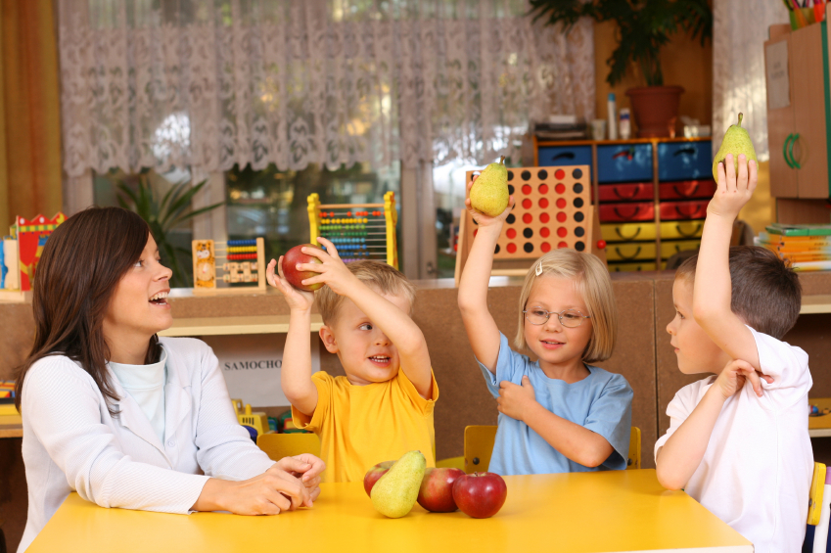
Intellectually, What Do Children Learn At the Table?
Language and Pre-Literacy
Mathematics
Science
Notes:
Read slide.

Slide 22
Language
Conversation
Mealtime conversations predict the growth and size of children’s vocabulary
Language stimulation + Interaction
Notes:
TELL: The meal table is a great place for conversation. In fact, research has found that the amount and complexity of mealtime conversation predicts children’s vocabulary size and growth. For instance, the more frequently a family has shared mealtime the larger a child’s vocabulary growth and the better their academic achievement. And children who heard unusual words at mealtime at age 2 had larger vocabularies at age 5.
TELL: In order to enlarge their vocabularies, children need not only language stimulation (hearing language) but also language interaction (give and take, back and forth). The real key is using language to describe children’s experience. This is how children learn new words.

Slide 23
What things do you do to encourage language development?
Notes:
ASK: What things do you do to encourage language development? Wait for responses then move to next slide.

Slide 24
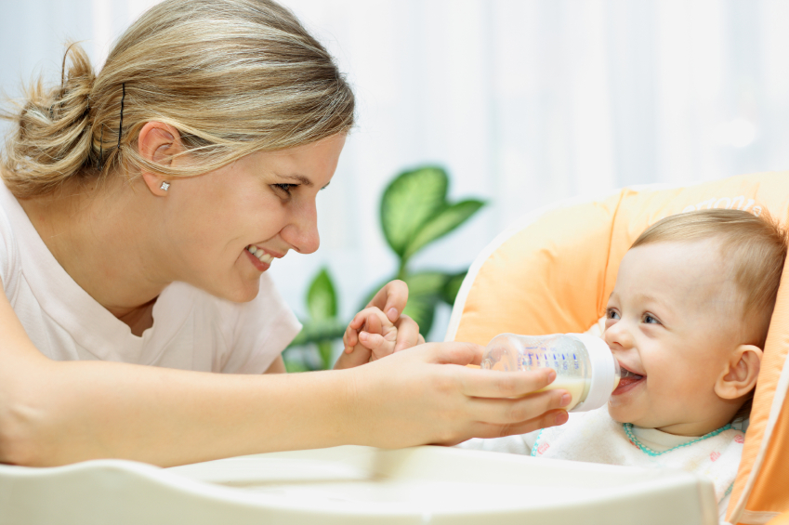
Creating Great Mealtime Conversations
Create joint attention and then name the experience
Elaborate on their language
Ask open-ended questions
Play with letter sounds
Direct the conversation
Notes:
TELL: Here are some keys to encourage language development.
TELL: Create joint attention. This can be done with infants. Make sure you and the child are paying attention to the same thing and then talk about it. “Oh, you see the cup! Are you thirsty?”
TELL: Elaborate on language. When children use one or two words, respond to them by adding to their words. “Milk? Should I pass the glass of milk?”
TELL: Ask questions to which you don’t know the answer. For example ask “Hannah, what is your favorite food?” or “Jesus, what foods grow in your garden?”
TELL: Point out words that rhyme. “Here is corn. Born, torn.” And encourage children to try to rhyme – even with nonsense words.
TELL: Direct conversation by letting every child speak but staying on topic. For instance, summarize what one child said and then ask another child to comment and remind children of the topic.

Slide 25
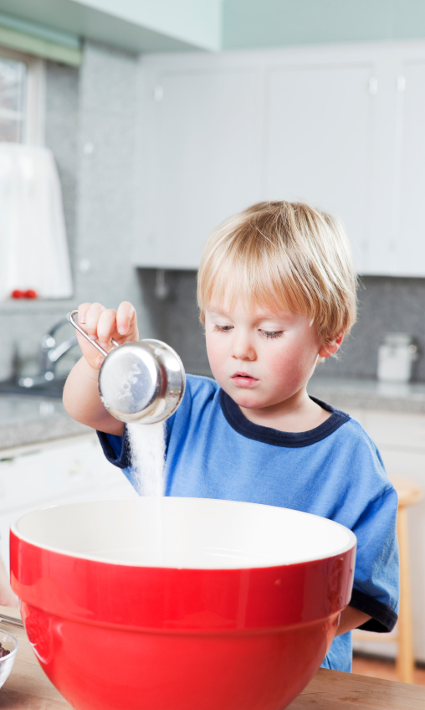
Mealtime Math
1-to-1 Correspondence
“1” is the same regardless of whether it is an apple or an orange.
Setting the table by matching each item to the number of chairs or people.
Simple arithmetic – adding and subtracting
If Michael’s mom joins us for lunch, how many plates do we need? If Kim is absent?
Fractions
Have children divide snacks or food evenly – 3 pieces of fruit between 2 children.
Notes:
TELL: The meal table also provides many opportunities for children to learn about numbers and practice mathematical concepts such as counting, adding and subtracting or fractions.
READ SLIDE.

Slide 26
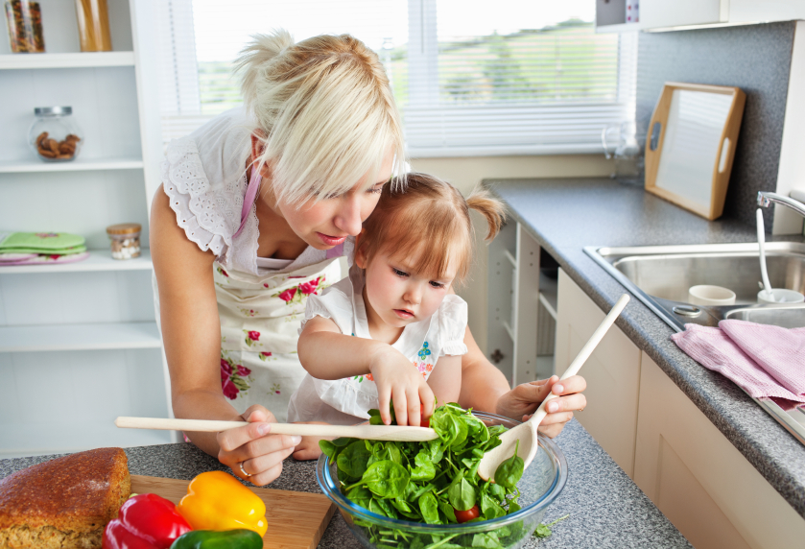
(Food) Science
Growing food
Natural Science: Where does food come from?
Growing plants in the classroom and measuring plant height each week
Cooking food
Basic Chemistry: How does food change when it is cooked?
Conservation of Identity (Logic)
If the appearance of something changes does the thing change?
Pouring water into different sized containers
Notes:
TELL: Science is yet another way intellectual development can be promoted at meal time. Most science learning in early childhood concerns the natural world – and food provides the first and most compelling example of the natural world because children have daily exposure to food. For example, some of the science questions children can answer at the meal table are (READ SLIDE)

Slide 27
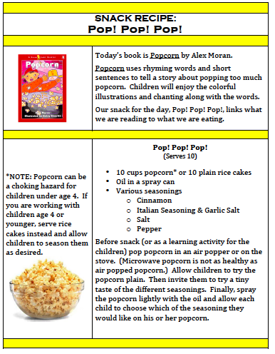
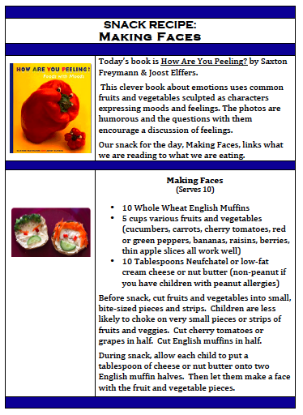
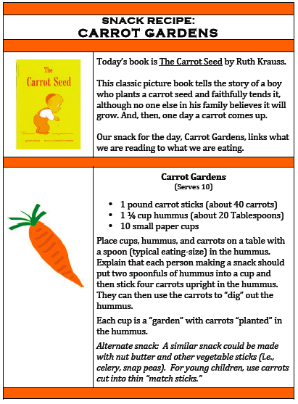
Intellectual Development Activity
Notes:
TELL: The Carrot Gardens activity we completed earlier today is a great example of how we can support children’s intellectual development at the meal table. By reading a book related to the food children are eating they can learn more about that food and books like The Carrot Seed can also help children understand how food is grown. The book and snack could even be accompanied by a trip to a farm or garden, the farmer’s market or growing seeds in the classroom. We’ve developed 4 snack and book activities that I’m passing out for your to try in your classroom.
DO: Hand out activity sheets.

Slide 28
Ideas for Mealtime Intellectual Development
In your small group, identify a note taker and reporter to share ideas with the larger group.
Then, brainstorm several ways to use mealtime (or snack) to promote children’s intellectual development in one of the following areas:
1) Language, 2) Math, or 3) Science
Also list the supplies & steps you would need to take to make your idea a reality.
Notes:
Facilitator:
Split large group into small groups of 3-4. Provide writing utensils and paper (maybe poster-sized paper and markers). Assign each group one area of intellectual development (language, math or science). Allow 5-10 minutes for small groups to come up with ideas and then another 5-10 minutes for small groups to present ideas to the larger group. NOTE: If your group is very small, the whole group could brainstorm for all three areas.
TELL: Here’s an opportunity to share more of your classroom wisdom and ideas. For the next 5-10 minutes, I’d like you to work with a small group to come up with classroom activities or methods that you could use in your early care & education setting to help children develop intellectually in the ways we’ve been discussing. For example, what kind of mealtime activity could you do to teach children colors or shapes or counting? What kind of activity could you do at snack to encourage and teach conversation? What kind of science concepts could you teach with mealtime? We’ll then spend another 5 minutes of so sharing ideas with the large group so you all hopefully will go home with a nice start to a library of ideas to use.

Slide 29
As We Share . . .
Please, take your own notes.
We will use them later.
Notes:
TELL: As we share ideas with each other, we suggest you take notes of the ideas shared because you’ll have a rich list of ideas and at the end of this workshop we’ll be asking you to share an activity or method you plan to use.

Slide 30
Closing
Children develop intellectually and socially through participation in mealtimes.
Because mealtimes become ritualized, with the same rules and actions repeated every day, they are a more effective setting for teaching and learning than are most other parts of the childcare day.
Notes:
TELL: To close, we’d like you each to share two activities you plan to use in the future – one that promotes social development and one that promotes intellectual development. I’ll give you 2-3 minutes to look through your notes and pick 1 activity for social development and 1 activity for intellectual development. Please write them on the Two Activities sheet I’m handing out. (If you have time, go around in circle or popcorn so you hear from each participant.)
After participants share two methods/complete worksheet . . .
TELL: Thank you for attending today. I hope that you are leaving with a deeper understanding of how social and intellectual development can be fostered at meal and snack times.

Slide 31
Development of this educational program was made possible by a generous donation from an alumna of the School of Human Ecology, UW-Madison.

