Slide 1
Toward Shared Outcomes
Supportive Developmental Relationships and Social Capital
Expanding Access, Equity, Opportunity
Post-Secondary Pathways
Youth Leadership Development, Youth Voice, Youth-Adult Possible Outcomes:
Partnership

Slide 2
Plans of Work, Program Development & Evaluation Highlights

Slide 3
Program Development Cycle

Slide 4
Shared Outcomes

Slide 5
2019 Plans of Work
What are PYD colleagues priorities? What are the most significant issues colleagues are addressing?
Audience Purpose of Work Intended Goals Evaluation Plans

Slide 6
2019 Plans of Work - Major Areas of Focus
Positive Youth Development Institute - Primary Program Focus in Plans of Work 2019
Primary Programming Area | Community Youth Development | Wisconsin 4-H | Total
Other major program area or strategy | 3 | 2 | 5
Generic PYD program | 3 | 1 | 4
Leadership / Camp counselor training | 0 | 1 | 1
Strenghten Relationships with Community Partner Orgs | 1 | 0 | 1
Workforce & Post Secondary Pathways | 1 | 5 | 6
STEM | 1 | 4 | 5
Life Skill Development | 0 | 2 | 2
Health | 2 | 0 | 2
Social-Emotional / Mental Health | 2 | 0 | 2
ATOD | 2 | 0 | 2
Nutrition & Physical Fitness | 1 | 0 | 1
Expanding Access | 3 | 4 | 7
Civic Engagement | 5 | 2 | 7
Service-learning focus | 0 | 1 | 1
Youth in Governance | 1 | 0 | 1
High Quality Programs | 1 | 8 | 9
Volunteer Development | 1 | 14 | 15
N =49Plans included (N-15 CYD, N=34 PYD)

Slide 7
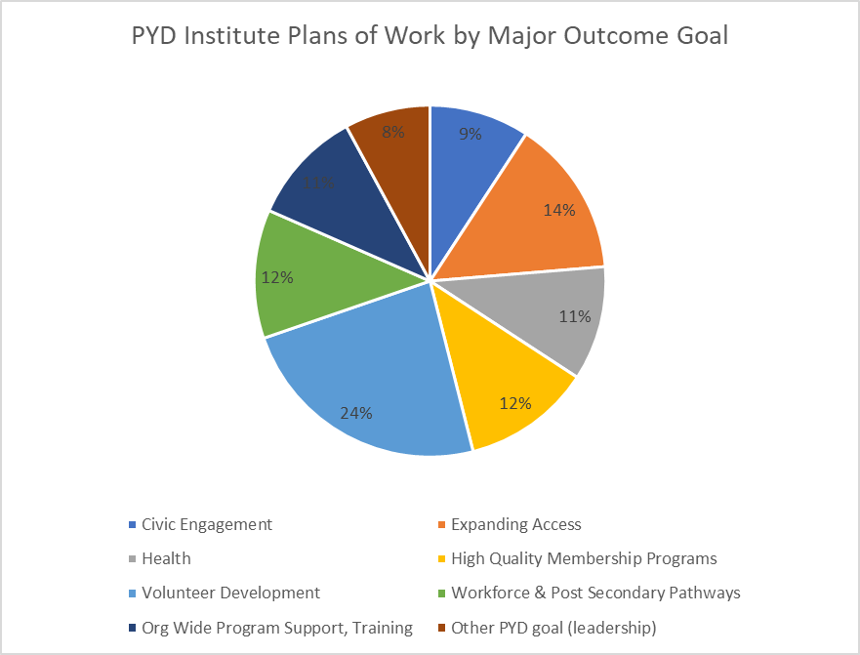
2019 Plans of Work - Major Areas of Focus

Slide 8
2019 Outcomes
What is the impact of our work?
What common outcomes are colleagues reporting? Are reported outcomes short, medium, or long-term in scope? What types of evidence are being reported to document the changes?

Slide 9
PYD Institute Outcomes reported 2019 (Q1-Q2)
Category | WI-4-H | CYD | Total
OUTCOME CATEGORY
Unclear/No Outcome Stated | 3 | 2 | 5
Other Outcome | 11 | 3 | 14
Health and Wellness | 2 | 3 | 5
Building Social Networks | 6 | 1 | 7
Exapanding Access | 6 | 1 | 7
Post Secondary | 8 | 4 | 12
Youth Adult Partnership | 6 | 1 | 7
Youth Leadership | 5 | 1 | 6
OUTCOME LEVEL:
Organizational Outcomes | 6 | 2 | 8
Individual Outcomes | 26 | 9 | 35
OUTCOME TYPE
Medium Term Outcomes | 10 | 3 | 13
Short Term Outcomes | 23 | 9 | 32
N = Documents Reviewed | 34 | 15 | 49
Intersections
Common Outcomes
(especially shorter - term)

Slide 11
Plans of Work
Existing Data Sources
Potential Data
Audience
Purpose of Work
Intended Goals
Evaluation Plans
Outcome Statements
Scholarly Products
Participation Records
Partnership Records
Community Events & Media Outreach
Expanding Access Records
Key Informant Interviews
Better Partnership Engagement
Identify some common medium term outcomes that can be tracked in each program area
Identify a few shared measurement tools (Thriving Model, Youth & Community Survey, Others)
Document, document, document
Other innovative ways to tell a data-driven impact story
How can we be more intentional about evaluating our work? In what ways can we tell the story of how local programming is part of something bigger?

Slide 12
Coming Soon
Movement toward a few common, shared outcomes to work towards.
New guidance on Plans of Work for 2019
Continued Zoom-based office hours support for Plans of Work, Outcome Statements, and other reporting
Lunch & Learn Series on a variety of Evaluation Strategies (Including 2 sessions that will highlight local evaluation data.
Identify & Recommend some measurement tools to track common outcomes (the short-term, longer-term, and level of change occurring (individual-level, organizational-level, community-level))
Program Managers will offer further info & guidance

Slide 13
Toward Shared Outcomes
Supportive Developmental Relationships and Social Capital
Expanding Access, Equity, Opportunity
Post-Secondary Pathways
Youth Leadership Development, Youth Voice, Youth-Adult Possible Outcomes:
Partnership

Slide 14
What do we mean by a common or shared outcome?
Youth Leadership Development, Youth Voice, Youth-Adult Possible Outcomes:
Partnership
Why are the benefits of doing this?
WI 4-H
What are some of the challenges?
Expanding Access, Equity, Opportunity
PYD Program Impact at Individual, Organizational, Community Levels
CYD
Supportive Developmental Relationships and Social Capital
*Shared Measurement Tools to help tell a uniform, consistent, rigorous story of impact.
*Enhances program area evaluation, local level evaluation, statewide evaluation
*Provides a roadmap for our work.
Post-Secondary Pathways

Slide 15
Establish community systems to support youth in college access
An "activity or event (1)" for "audience (2) " , where "what you did (3)" to "outcome/difference you make (4)" .
Grouping similar approaches or outcomes to help define and visualize where are locally driven programming has a common major goal.
Individual
Workforce/Post-Secondary
Youth increase their knowledge of post-secondary career opportunities
Expand capacity of community organizations to include and engage youth through youth-adult partnerships
Organizational
Systemic

Slide 16
An "activity or event (1)" for "audience (2) " , where "what you did (3)" to "outcome/difference you make (4)" .

Slide 17
Youth Leadership Development, Youth Voice and Youth/Adult Partnership
Possible Outcomes:
# Structured opportunities with authentic youth leadership
Adults with greater skills to support youth leadership
Youth report programs and opportunities support youth voice (4-H Thriving Developmental Context Measure)
Etc.
Example: 4-H Youth Horse Committee Develops Own By Laws A series of workshops and discussions with the 4-H Youth Horse Committee where we collaboratively developed a set of bylaws to guide the operations of their youth-led committee.

Slide 18
Expanding Access, Equity, Opportunity
Possible Outcomes:
Youth strengthen cultural identity and cross-cultural learning
Volunteers understand and implement welcoming environments
Volunteer and youth demographics become more representative of county population
Etc.
Example: Annual 4-H Leader Training - All Together, Not All the Same An annual training for 4-H leaders where they participate in discussions and activities about cultural awareness and inclusivity to help them with efforts to expand diversity and outreach to underserved populations in their county 4-H programs

Slide 19
Supportive Developmental Relationships and Social Capital
Possible Outcomes:
Youth experience supportive relationships (4-H Thriving Developmental Context Measure)
Youth and/or adult volunteers strengthen social networks and social support (Social network analysis, 4-H Thriving or Civic Engagement Measure (Flanagan))
Etc.
Example:

Slide 20
Post-Secondary Pathways
Possible Outcomes:
Sparks (4-H Developmental Context Measure)
Knowledge of 4-year college and other post-secondary options (4-H Common Measures)
Etc.
Example: Robotics Program - A week long event for youth where they learned robotics to increase their ability to problem solve, critically think, engineer, and use technology.

Slide 21
Establish community systems to support youth in college access
An "activity or event (1)" for "audience (2) " , where "what you did (3)" to "outcome/difference you make (4)" .
Grouping similar approaches or outcomes to help define and visualize where are locally driven programming has a common major goal.
Individual
Workforce/Post-Secondary
Youth increase their knowledge of post-secondary career opportunities
Expand capacity of community organizations to include and engage youth through youth-adult partnerships
Organizational
Systemic

Slide 22
Questions?

