Slide 1
Delivering actionable messages: a plain language workshop
Erin Aagesen, MS, MPH
Health Communications Outreach Specialist
UW-Madison Division of Extension

Slide 2
Today
Introduction to health literacy
Oral communication strategies
Oral communication practice
Jargon game
Complex chat
Questions

Slide 4
What is health literacy?

Slide 5
Skills required
Reading
Writing
Numeracy
Culture
Politics
Technology

Slide 6
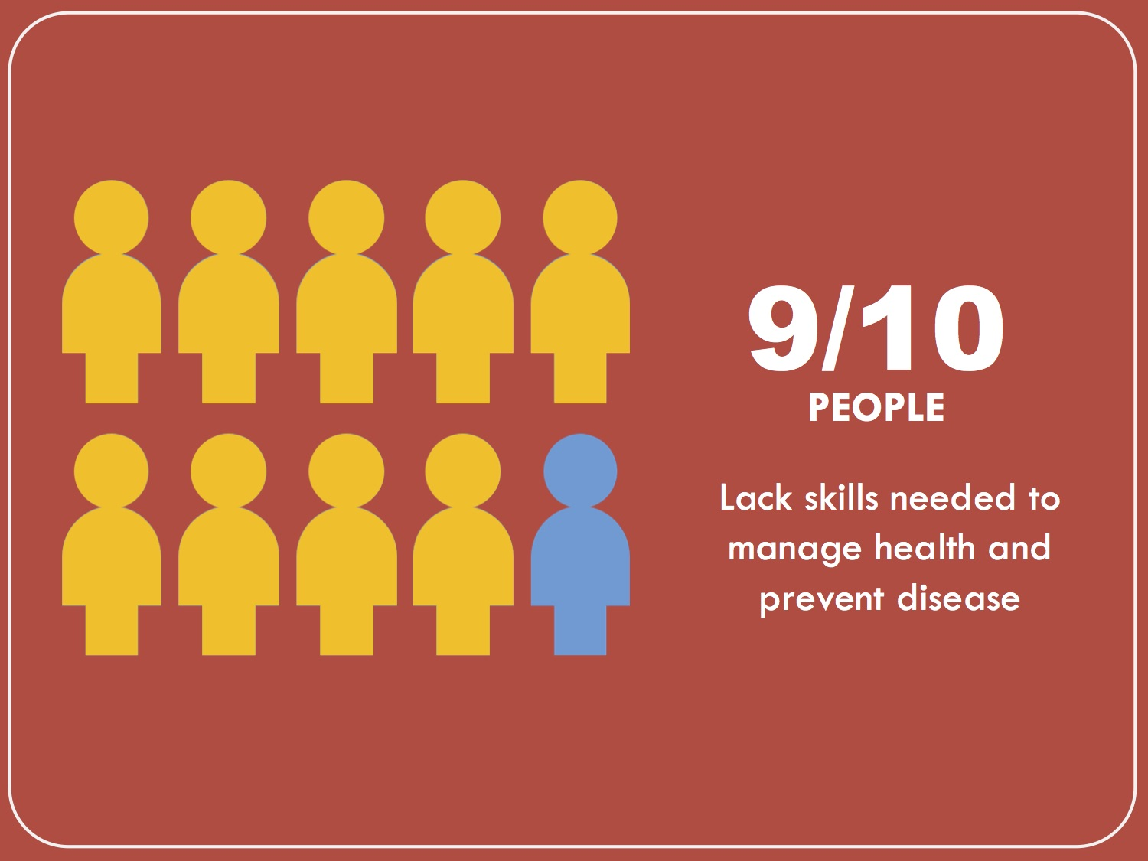
Who is affected?

Slide 7
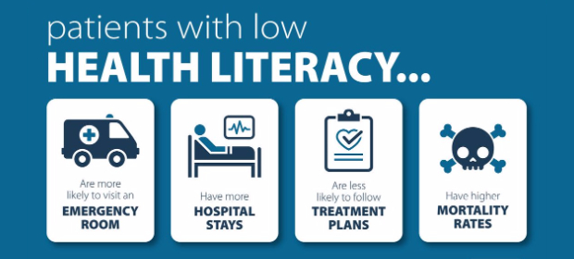
Scientific American – 60 second health
Notes:
https://www.healthypeople.gov/2020/topics-objectives/topic/social-determinants-health/interventions-resources/health-literacy

Slide 8
Health literacy is a two-way street
Demands/Complexity
Health literacy
Skills/Abilities

Slide 9
The role of shame
People with literacy issues often hide
Even from close friends/spouse
Don’t expect people to speak up
May appear engaged or have strong verbal skills

Slide 10
Red flags
“I forgot my glasses at home.”
“I’ll look at this later.”
“My wife usually handles this type of thing.”
No questions / nod and smile
Frequently missed appointments/classes

Slide 11
What can we do?

Slide 12
Universal precautions approach
You can’t tell by looking who might have low/limited literacy
Use plain language strategies for all

Slide 13
Plain language communication
Is respectful (of people’s time, energy, resources)
Is actionable (directly states goal)
Leads to better outcomes (by prioritizing where to put effort)
Is preferred even by highly educated *
(*Research confirms.)

Slide 14
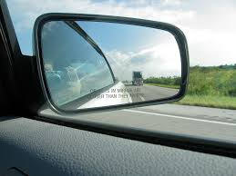
Your “expert blind spot”
We all have one.
We have invested years of our lives on:
Education
Work experiences
Life experiences
We use jargon and acronyms daily.
We no longer see the challenges others experience.
We want others to understand this topic as well as we do.
We want to help (really, we do!). But we are not helping when we start from this place.

Slide 15
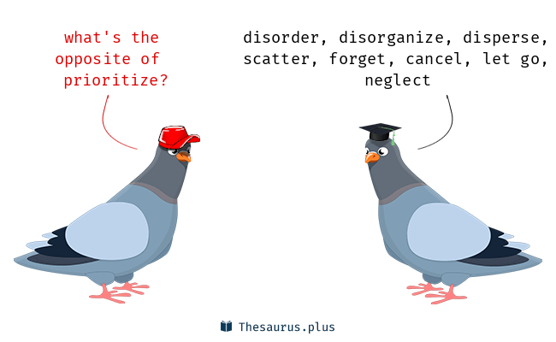
“Nice to know” versus “Need to know”
When we communicate, our goal should not be to teach others everything we know about a topic.
Use your expertise to help others sift through the “noise”! Help people prioritize.

Slide 16
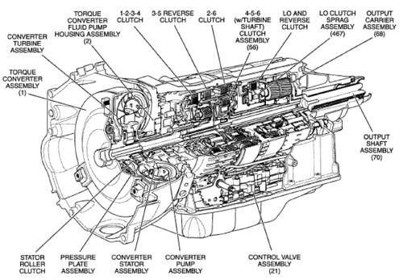
If you are getting your car fixed…
This?
Or this?
“Come back to the service station when your car reaches 50,000 miles.”

Slide 17
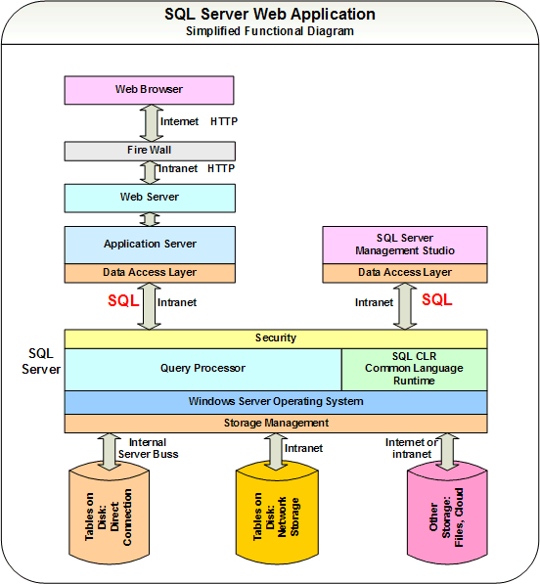
If you are having trouble with your computer…?
This?
Or this?
“Submit a helpdesk ticket if you continue to have issues.”

Slide 18
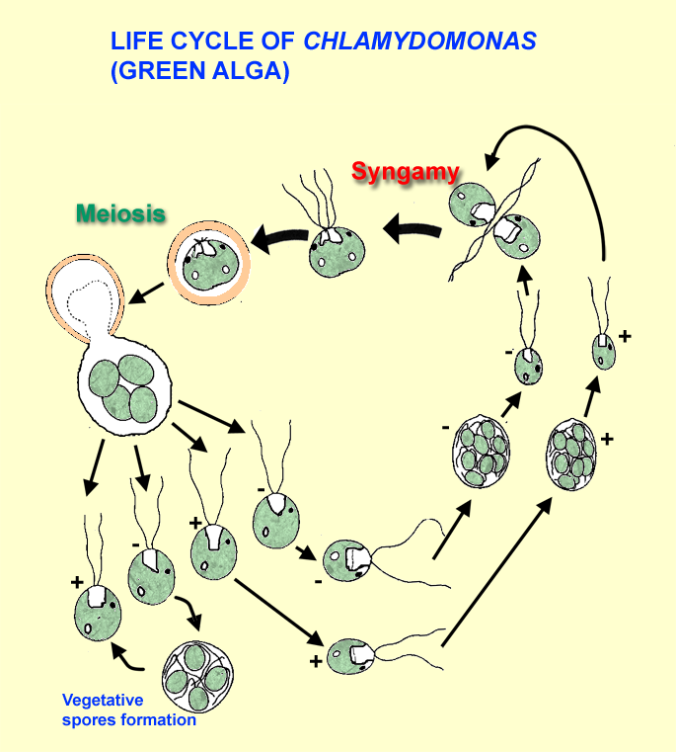
If you are going swimming in a WI lake, do you want…?
This?
“Check our Facebook page for updates on harmful algae blooms in area lakes.”
Or this?

Slide 19
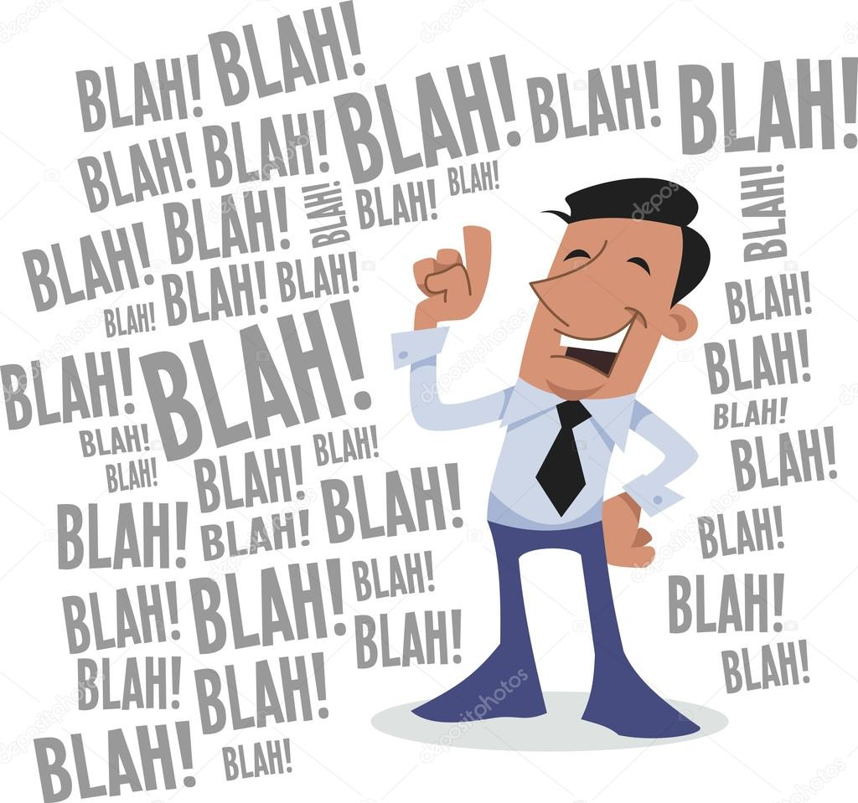
When you are speaking, what do you want?
This?
Or this?

Slide 20
Jargon game Groups of 5-6 people 15 minutes

Slide 21
Focus on action steps
Most people remember (at most) three main takeaways.
What do you want people to remember?
Requires clarity about intended audience and purpose.
Pick one goal and stick to it!

Slide 22
Use analogies
Analogy = “X” is like “Y”
Builds off of existing knowledge.
Creates a bridge to new information.
Examples in Health and Well-Being Institute:
“The heart is like a pump.”
“Nutrients are like building blocks for your body.”
“Depression feels like you are in black and white when the rest of the world is in color.”

Slide 23
Complex Chat Groups of 5-6 people 20 minutes

Slide 24
Confirming understanding
Step one: Take the shame out.
“This topic is confusing for a lot of people that I speak with.”
“When I first heard about this, I struggled to understand it.”
Step two: Take responsibility.
“I want to make sure I was clear.”
“I want to make sure I did my job.”
Step three: Assume there are questions.
“What questions do you have?”
No: “Do you have any questions?”

Slide 25
What questions do you have? erin.aagesen@wisc.edu

