Slide 1
Positive Youth Development Institute Meeting
November 18, 2019
Notes:
Goal:
Clarify 4-H and CYD goals and roles
many roles in the room, single or dual
not all local programs look the same, but we need shared purpose
process began with staff being all things to all people, famous list from professional concerns
Program planning follows clear vision, intention

Slide 2
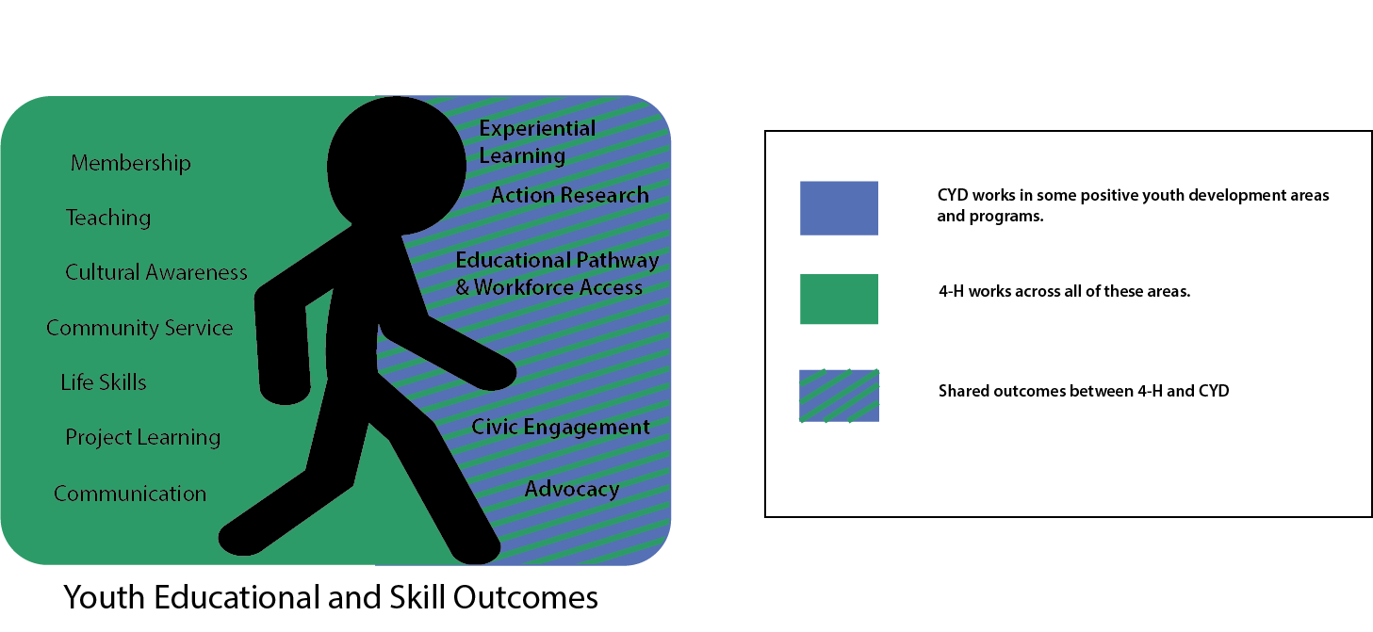
4-H and Community Youth Development Focus: OUTCOMES

Slide 3
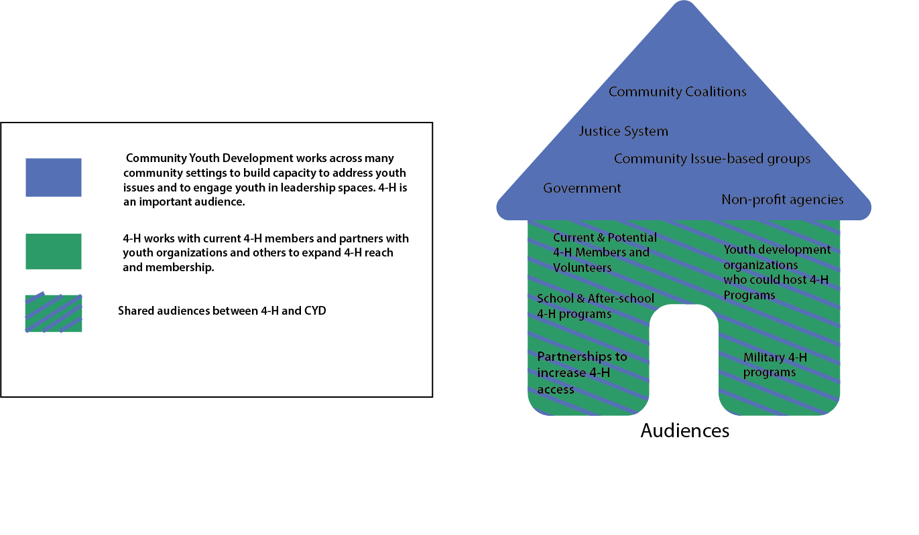
4-H and Community Youth Development Focus: AUDIENCES

Slide 4
Wisconsin 4-H Program Model
The development of the 5cs of caring/compassion, competence, character, connection and confidence
An asset based approach that provides active support for the growing capacity of young people.
A planned set of activities (programs)that foster the growing capacity of young people.
Community Youth Development

Slide 5
Wisconsin 4-H Program Model
The development of the 5cs of caring/compassion, competence, character, connection and confidence
An asset based approach that provides active support for the growing capacity of young people.
A planned set of activities (programs)that foster the growing capacity of young people.
Community Youth Development
Emphasizes a 6th C of youth Contribution to families, neighborhoods and communities using the other 5 C’s.
Focuses on collaboration and partnerships for the development of communities.
Program environments incorporate the developmental components to the left.

Slide 6
Wisconsin 4-H Program Model
Focuses on the meaningful and positive development within its programs.
Includes components that promote CYD, including Post-Secondary Pathways & Civic Engagement.
Promotes individual youth outcomes.
Targets school-aged youth audience.
Community Youth Development

Slide 7
Wisconsin 4-H Program Model
Focuses on the meaningful and positive development within its programs.
Includes components that promote CYD, including Post-Secondary Pathways & Civic Engagement.
Promotes individual youth outcomes.
Targets school-aged youth audience.
Community Youth Development
Focuses on the interaction of the individual with his or her environment
Works across community settings to build capacity to address youth issues and engage youth in leadership spaces. 4-H is an important setting.
Focuses on organizational or community outcomes.
Targets an adolescent and young adult audience.

Slide 8
4-H and CYD Shared Spaces
While CYD has a primary focus on community capacity building and youth voice, 4-H staff also work with partnerships to create positive youth development opportunities for all youth and to expand connections for 4-H programs.
4-H programs and approaches can be a model for other youth programs in positive youth development practices.
CYD staff may build 4-H membership opportunities into educational programming they develop and support.
Notes:
Example:
If Youth Vaping is an issue: CYD may convene a community-wide response, working with public health, schools, youth organizations, bring in outside expertise, engaging youth voice, etc.
4-H may join a community-wide response (bringing resources and programs to 4-H, engage 4-H members and groups in community actions)
Juntos program has several components: school-based services, family education, and a 4-H club.
New message? About intention, purpose, clarity of program goal (not hard and fast rule about what spaces you work in)
Questions—space at end, work with your PM/APM

Slide 9
Elevator Conversations with your AED
1 – What is 4-H and what do you (staff) do?
2 – What is CYD and what do you (staff) do?
3 – How can 4-H and CYD work together if we have both?
Notes:
AED

Slide 10
Next steps
At your table, list 2-3 remaining questions or burning issues
Notes:
Planning a Zoom with AEDs

