Slide 1
Human Development and Relationships Institute
2018 All Program Meeting
Danielle Y. Hairston Green
Director, Human Development and Relationships

Slide 2
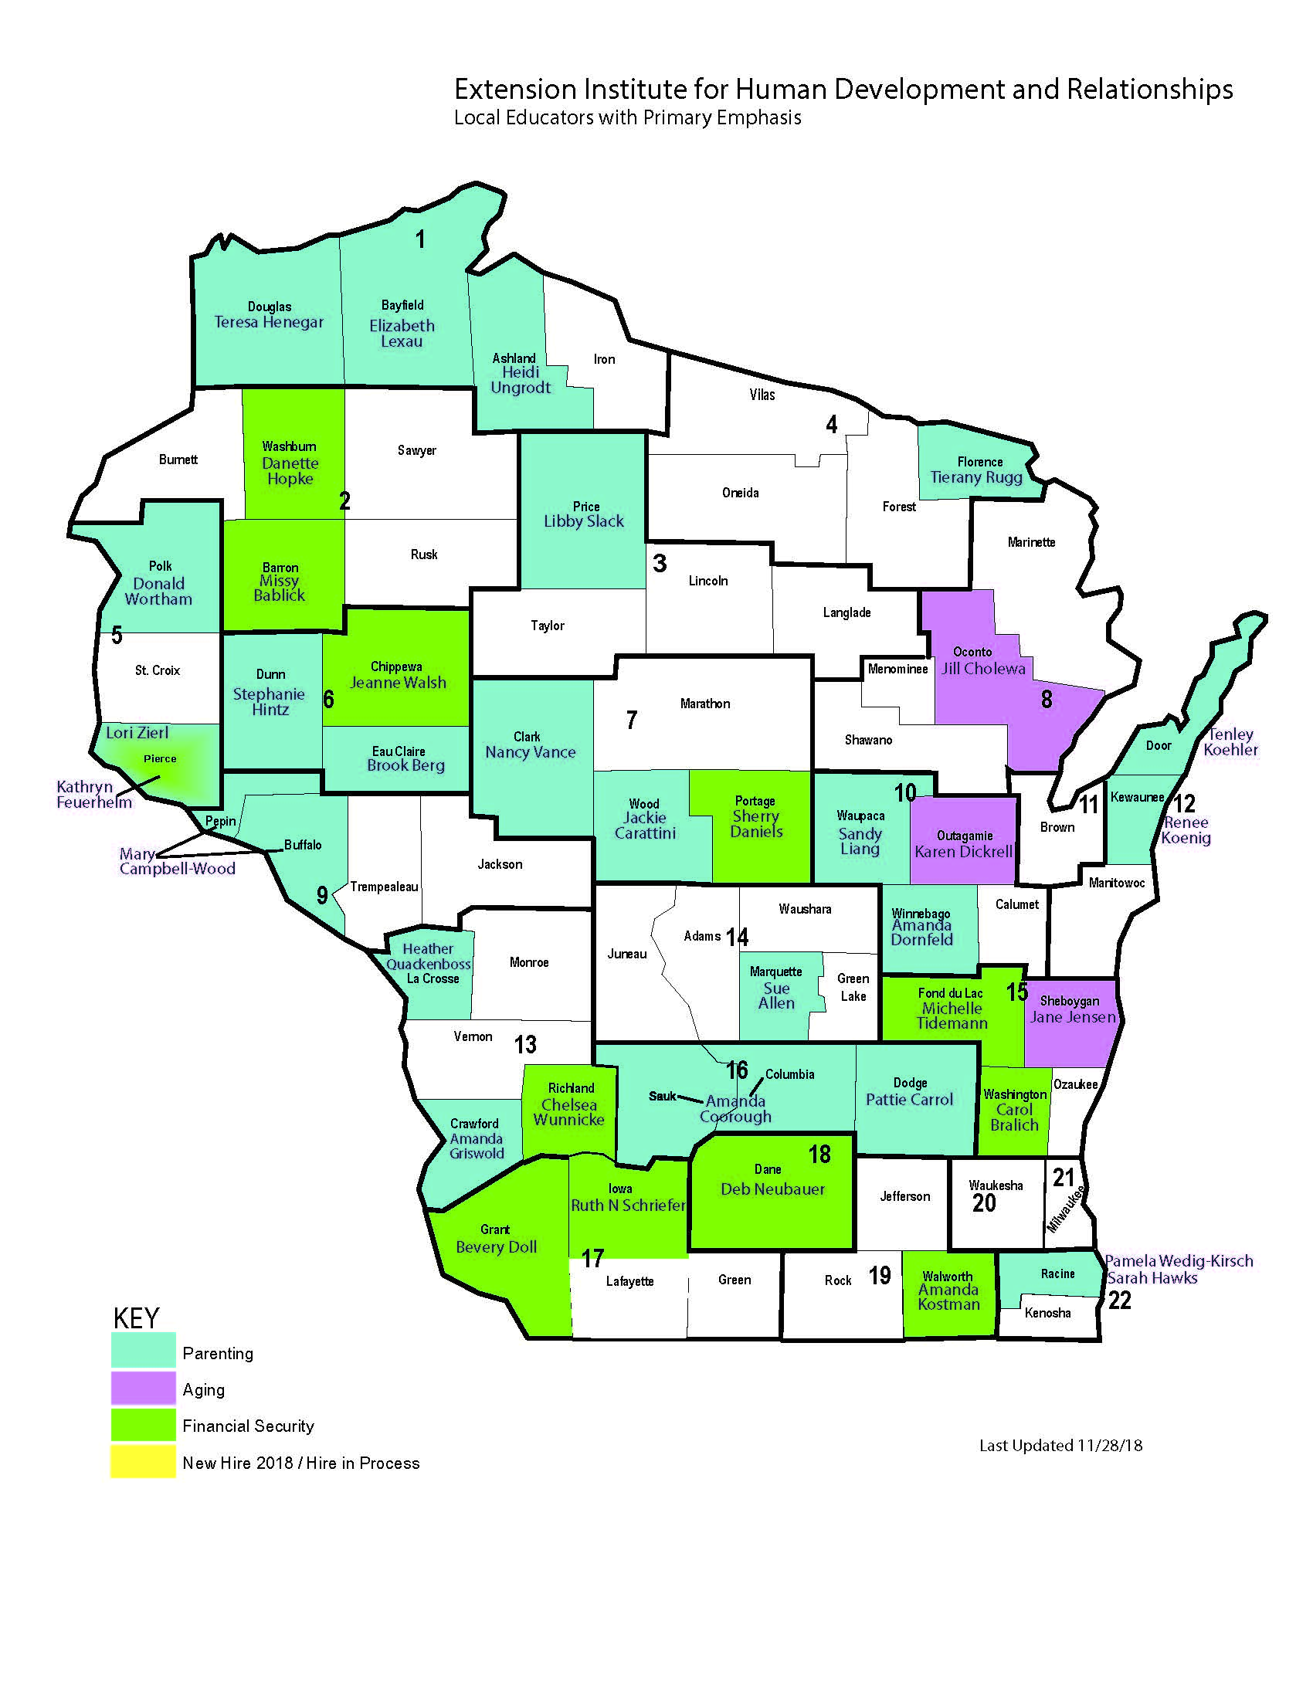
Welcome
New Colleagues FALL 2018
Notes:
Amanda Griswold, Crawford County
Heather Quackenboss, Lacrosse County
Amanda Coorough, Sauk County
Heidi Ungrodt, Ashland County

Slide 3
Notes:
Getting To Know Your Colleague:
The wizard Gargamel created 'SMURF' to cause jealousy and to spy on the 'SMURF' village. She was the desire of all of the ‘SMURFS’ in the village. When she arrived her hair was black and she looked little different but papa 'SMURF' took her in and took her to his lab and made her look more like a 'SMURF' and taught her the 'SMURF' language. She was always in the center of chaos but still the desire of the 'SMURF's. She even went on trial, and acquitted, for her bad behavior. Eventually she left the village but would visit every now and again stirring up more controversy. She took to marrying the grouchiest 'SMURF' in the village, who proclaimed never to marry and to never to love.

Slide 4
WHEN LOVE TAKES OVER
Notes:
Getting To Know Your Colleague:
When Love Takes Over by Yolanda Adams
This is the song, among so many, that motivates me in the morning. It was written as a bit of a love song between an individual and GOD. But, it can even be interpreted as a love song between two individuals. But, I look at it as falling in love with life. The moment I realized what my purpose was in life I felt like I fell in love. I felt like it was a long a painful journey to get to that point because I met so many disappointments along the way.

Slide 5
What’s Happening in HDR?
New Hire Dane County
Bilingual Financial Educator
New Position Posting Forest County (January 2019)
Forest County Potawatomi Human Development and Relationship
Extension Educator
New Position Posting (February 2019)
Program Manager Positions
Proposed Extension
Lori Zierl, Liaison, 12 months

Slide 6
What’s happening in HDR?
Mixer (March 2019)
“Strengthening Under-represented Families and Children of Color: Combatting issues of Wealth, Health and Education Disparities in Wisconsin.”
Chancellor’s Imperative: Convene new partners on campus (not necessarily engage where we are already well connected), but also highlight potential areas of scholarship in partnership with Extension. The Chancellor sees these events as a way to help UW Madison take advantage of extension’s statewide presence and for the Cooperative Extension to benefit from some of the research and outreach efforts underway at Madison.

Slide 7
TEAM CHALLENGE
Notes:
Card Game (Instructions in Envelope):
Debrief (Midpoint):
How do you feel? One word.
Debrief (Conclusion):
What happened when a new person arrived at your table?
When you moved to a new space what were your feelings?
How does the activity relate to current conditions in uwex, previous conditions, future conditions?
How does this activity help you moving forward in your work?

Slide 8
HUMAN DEVELOPMENT
Human Development: The process of enlarging people’s freedoms and opportunities and improving their well-being. (Measure of America, United Nations Development Program)

Slide 9
Pillars
EQUITY
SUSTAINABILITY
PRODUCTIVITY
EMPOWERMENT
COOPERATION
SECURITY
Notes:
Equity is the idea of fairness for every person, between men and women; we each have the right to an education and health care.
Sustainability is the view that we all have the right to earn a living that can sustain our lives and have access to a more even distribution of goods.
Productivity states the full participation of people in the process of income generation. This also means that the government needs more efficient social programs for its people.
Empowerment is the freedom of the people to influence development and decisions that affect their lives.
Cooperation stipulates participation and belonging to communities and groups as a means of mutual enrichment and a source of social meaning.
Security offers people development opportunities freely and safely with confidence that they will not disappear suddenly in the future.[

Slide 10
BREAKOUT PART ONE
PILLARS DISCUSSION TRIGGERS:
What does this pillar mean to you?
How does this pillar apply to your life: professionally/personally?
How can you be more intentional about addressing this pillar in your professional and personal life?
Notes:
Each table will have a different Pillar focus.

Slide 11
ISSUES AS KEY THEMES
Workplace and Workforce Development
Jobs
Skill Development
Population Health
Health Necessities
Alcohol and Drug Use/Abuse
Notes:
Jenna Klink

Slide 12
ISSUES AS KEY THEMES cont.
Infrastructure
Housing
Environment & Stewardship
Water Quality
Social Infrastructure
Organizations limited adequate/equitable services
Misperceptions and misunderstandings

Slide 13
Program Area Breakout
Family Relationships
Parenting
Aging
Financial Education
Healthy Living
Undecided
Notes:
Distribute handouts to help the team recognize issues. The handout will help you determine if the issues that you want to address is
Sustainable,
Equitable
Empowering
Support Safety
Support Productivity and Cooperation.

Slide 14
BREAKOUT PART 2
PROGRAM AREA DISCUSSION TRIGGERS:
What did you discuss in your Pillar groups that could be applied in your program area?
Which one of the Pillar’s are not addressed in the work that you do?
Use the handout to process through identifying Issues related to any or all of the pillars?
What is the relevance, potential for collaboration and the impact to your plan of work?

Slide 15
S.I.G.N.
Notes:
How do you know when you are working within your strength and passion. What are the SIGNs?
66% OF YOUR LIFE IS IN A CONSTANT RUCK BECAUSE YOUR ONLY SOLICE IS ON THE WEEKEND….WE ARE LIVING FOR THE 33%.
Marcus Buckingham
#1 Strength that folks you talk to always seem to say that they have, especially in interviews? (Im Good With People).

Slide 16
SUCCESS
INSTINCT
GROWTH
NEEDS
DISCOVERING YOUR STRENGTHS
Notes:
Success. Certain activities make you feel effective, and accomplished, and in control. Self Efficacy.
Instinct. You look forward to doing these things. You are instinctively excited when you know the activity is approaching.
Growth. You feel like your brain is growing when you are engage in the activity. Two hours could pass and It feels like 5 minutes
Needs. The activity fulfill you, fills a need in you.

Slide 17
FINAL THOUGHTS?
NEXT ZOOM JANUARY 24, 2019
SIGNUP IF YOU ARE INTERESTED IN PLANNING THE MARCH MIXER
DANIELLE.HAIRSTONGREEN@CES.UWEX.EDU

